Slide 1
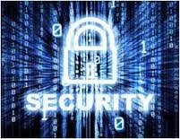
MS Ramaiah Institute Of Technology
“SECURITY IN SOCIAL NETWORKING”
Manoj More S (1MS13CS412) Guide : Mr. Ganeshayya Sidhaganti

Slide 2
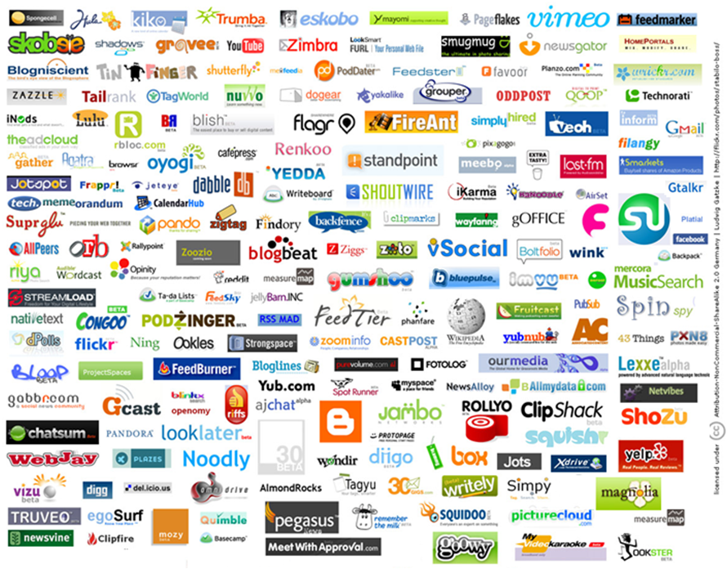
Security in social network (or) Online security issues

Slide 3
Over View
Introduction To SN & SSN.
Survey On Social Network.
Recent Attacks.
Privacy Related Thread.
Identity Theft Issues.
Spam Issues.
HTTP session Hijacking.
ARP & DNS Poisoning.
Grabbing Public Attention
Security guide in SN.
VPN Services.
Conclusion.
Bibliography.

Slide 4





Introduction to SN & SSN
What is Social Networking ?
“A social network service focuses on building online communities of people who share interests and/or activities, or who are interested in exploring the interests and activities of others.”
“Social networking sites…build on the concept of traditional social networks where you are connected to new people through the people you already know.”

Slide 5
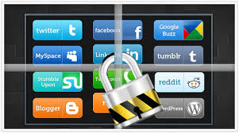
What is Security in social Networking ?
Security in Social networking defines the way in which the users info
is secured and The way in which users are authenticated to access the site and tell about the common security issues and attacks on live data
“YOUR PERSONAL INFO AND PROFILE IS THE ULTIMATE TARGET”
Of Hacker

Slide 6
Survey on Social Network
Number of users
Facebook 1.23 + billion
Myspace 36 + million
LinkedIn 300+ million
Twitter 270+ million
Gmail 425+ million
Yahoo 281+ million

Slide 7
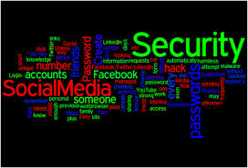

Recent attacks & Their Effect
Apple’s cloud
I-cloud hacked(Sept,2014)
Gmail Database
around 5million+ Password were leaked(sept,2014)
Yahoo mail attack
Jan 30,2014
LinkedIn 6.5 Million password

Slide 8

Privacy Related Threats
Users’ Anonymity:
Disclose of user name to the online world
1)De-Anonymization Attack
2) Neighborhood Attack
User’s Profile and Personal Information:
1) LOI through poor privacy settings
2) LOI to 3 rd party application and Domain

Slide 9
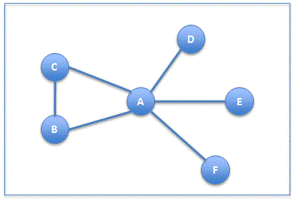
De - Anonymization & Neighborhood Attack

Slide 10
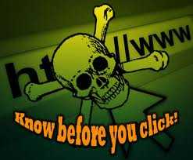
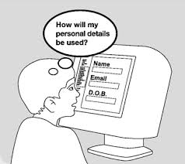
Identity Theft Issues
Profile Cloning:
duplicate or copy their profile information to create a false identity
1)Existing profile cloning (Facebook acc hacking).
2)Cross site profile cloning.
Social Phishing:
Creating the fake websites to obtain your data
eg: facebookHacker 2.6

Slide 11
Spam Issues
Congratulations u have won a I phone
Spam Attack on Social networking Sites
Spam comes in the form of wall post, news feed, and message spam
Email-Based Spam Attack on Social network Users
1.Broadcast Spam
2.Context-Aware Spam
(concept of A&B)

Slide 12
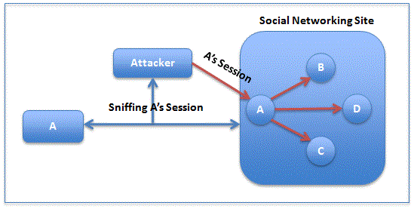
HTTP Session Hijacking
ARP cache poisoning or DNS poisoning. Attackers then capture HTTP headers that contain session cookies

Slide 13
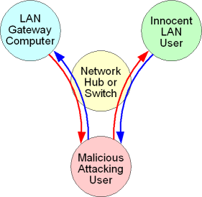
ARP cache poisoning
Fooling the parties and redirecting their messages to malicious user.

Slide 14
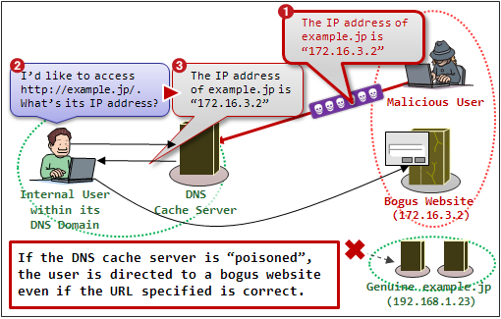
DNS poisoning
Miss leading the user by poisoning the DNS cache

Slide 15
Grabbing Public Attention
Attacker usually grabs public attention by…..
Creating a fake celebrity profile.
Creating a duplicate of somebody’s profile.
Creating a female profile and publishing a pretty picture of “herself”.
“ A lot of people use social networking sites to meet their partners online and many of these sites have specific tools to facilitate this.”

Slide 16
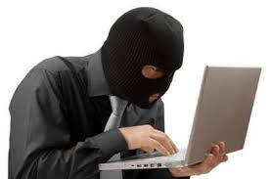
Security Guide to Social Networks
Publish comfortable information .
Connect people you trust .
Avoid clicking unexpected links.
Never fully trust anyone you do not know that well.
Evaluate your settings
Be wary of third-party applications
Use strong passwords

Slide 17
Cont…..
Use and maintain anti-virus software
Educate and Train Employees
Centralize Social Media Channels
Take the Necessary Steps to Protect Passwords
Institute a Messaging Approval System
Prepare for the Worst
Go for VPN services.

Slide 18
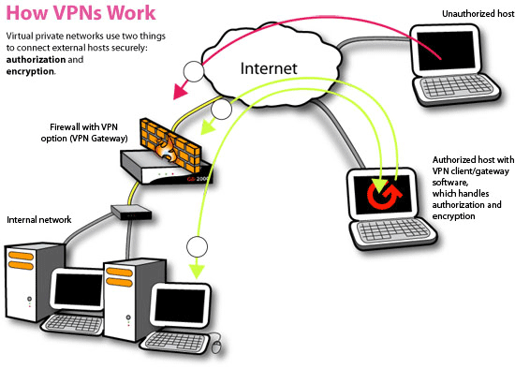
VPN Services
A VPN encrypts all your internet communications, thereby prevent anyone from tracking your internet activities and stealing your personal and sensitive information.

Slide 19
Why technology is essential to an effective security strategy
Strong policies and awareness programs can be reinforced.
Multilayered security at the gateway and the end points.
Content filtering, data loss prevention (DLP), and mobile device management (MDM) solutions.
DLP can quarantine an unauthorized or under protected message.
DLP solution provides with screening of the content before it leaves the network.

Slide 20
Cont…
MDM installed mobile devices enables capabilities such as remote wipe and lock, device encryption, and password enforcement.
Identifying the right combination of these security tools.
Security must leverage both decentralized and centralized modes.

Slide 21
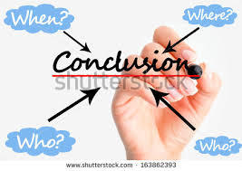
Conclusion
The opportunities provided from this medium are immense and many organizations are making use of this medium to better their practices. Organizations are no longer at the mercy of the media to advertise or convey their message. With the help of social networking they can advertise or communicate in a more efficient way
The world is getting closer everyday and everyone wants to be connected. After all the advantages, the problem that arises is of information overload and security. Social networks, unlike the common media. Too much of information may confuse users. Security might be another area of concern where people can get illegal access to a user’s information. The future of social networking looks very promising but still it has to deal with the problems associated with it.

Slide 22
Bibliography
[1] The Knesset research and information Center ,” Online Social Networking :Threads and solution”.
[2] Trend Micro ‘s , “ Security Guide to Social Networking” by
David Sancho.
[3] Rutgers University Technical Report ,” Evaluating the Security Risks of Freedom on Social Networking Websites”.
[4] “Survey on Privacy and Security issues in SN”, By Dolvara Gunatilaka
[5] IT Security Roundtable June 4, 2010,”Risk in Social Networking”
[6] “Secure Social Networking “ by Barbara McClellan.
[7] “Security Issues and Recommendations for Online Social Networks” By Giles Hogben, ENISA.

Slide 23

Any Questions ?

